Slide 1
The Judicial Branch

Slide 2
For the Quiz
Do you know the current Supreme Court Justices??
Do you know which president appointed them?
  ?
  ?
  ?
  ?
  ?
  ?
  ?
  ?
  ?

Slide 3
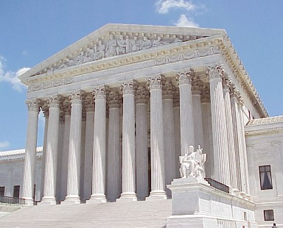
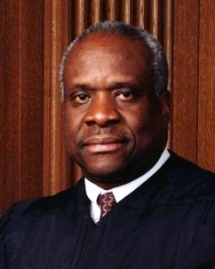
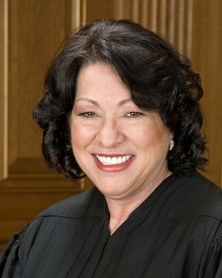
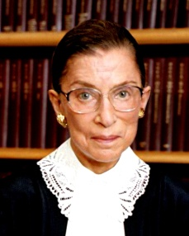
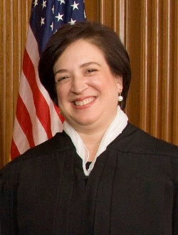
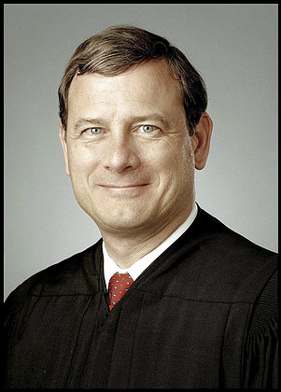
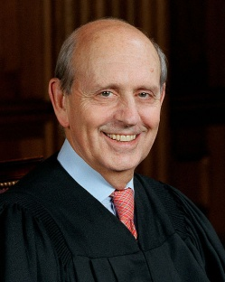
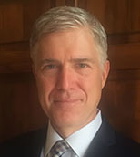
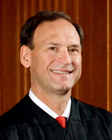
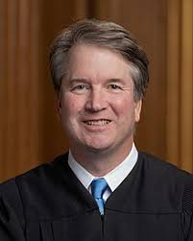
Clarence Thomas- GHW Bush
Ruth Bader Ginsburg- Clinton
Steven Breyer- Clinton
Samuel Alito- GW Bush
Sonya Sotomayor- Obama
Elena Kagan- Obama
Neil Gorsuch – Trump
Brett Kavanaugh – Trump
The Current
Supreme Court
Chief Justice John Roberts
Appointed by George W. Bush

Slide 4
The Creation of the Federal Judicial System
According to Article III, Congress can make new federal courts OR take away current federal courts but may not change the US Supreme Court
Federal judges and Supreme Court Justices serve for life (or good behavior)
Article III
  Section 1. The judicial power of the United States, shall be vested in one Supreme Court, and in such inferior courts as the Congress may from time to time ordain and establish. The judges, both of the supreme and inferior courts, shall hold their offices during good behaviour, and shall, at stated times, receive for their services, a compensation, which shall not be diminished during their continuance in office.

Slide 5
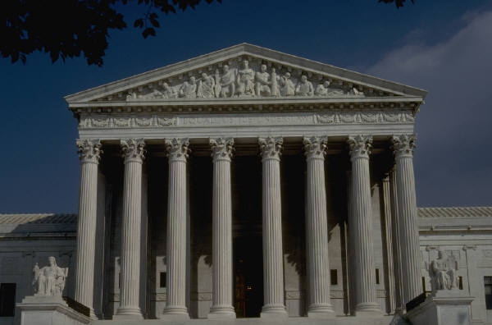
The Dual Court System
This means the Federal and State Court systems and how they function
Refers to the separate state court systems and federal court systems
  It’s an outdated way to describe the two systems

Slide 6
THE DUAL COURT SYSTEM
 | STATE COURTS | FEDERAL COURTS
Courts of Last Resort | State court of last resort (e.g., State Supreme Court | The U.S. Supreme Court
Intermediate Appellate Level | State intermediate courts of appeals | U.S. courts of appeals (Circuit Courts)
Trial Level (original jurisdiction) | Courts of general jurisdiction (law and equity) + Special or limited trial courts (e.g., probate court) | United States district courts + Specialty courts of limited jurisdiction (e.g., Tax Court)

Slide 7
The United States Court System
This one is more modern-
US Supreme Court
State Court of
Last Resort
U. S. Circuit Courts
of Appeal
State Supreme
Courts of Appeal
State Trial Courts
U. S. District Courts

Slide 8
Federal U. S. District Courts
There are 94 federal district courts, which handle criminal and civil cases involving:
  Federal statutes/laws
  The U.S. Constitution
  Civil cases between citizens from different states and the amount of money at stake is more than $75,000 (This is the most common type of case in the U.S. District Court.)
Appeals from here go to the U.S. Circuit Court of Appeals

Slide 9
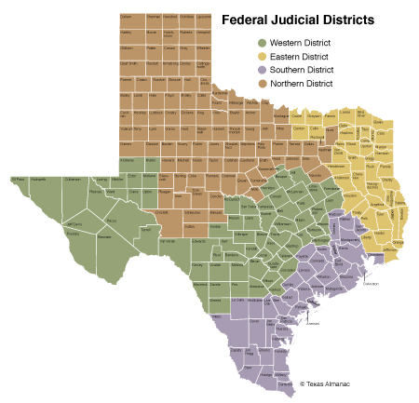
Texas Federal Courts
Texas is divided into FOUR federal district
  Northern – 7 divisions
  Eastern – 6 divisions
  Southern – 7 divisions
  Western – 7 divisions

Slide 10
U. S. Circuit Courts of Appeal
There are 12 of these courts.
  Each state is part of the 11 Circuit Courts.
  The Federal D.C Circuit Court is located in Washington, DC.
Each court reviews cases from the U. S. District Courts in its Circuit.
Appeals go to the U.S. Supreme Court.

Slide 11
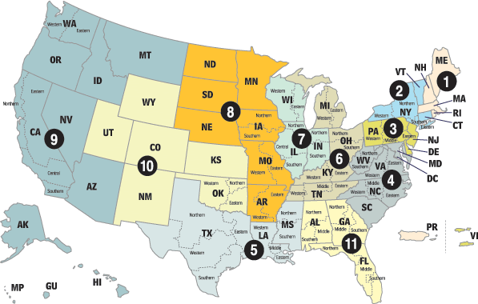
DC Circuit Ct.
Texas is in the 5th Circuit
Location: New Orleans

Slide 12
US Supreme Court
Route to the Supreme Court
  Most cases start in federal district courts and the federal circuit or appeals court
    These are called appellate cases which means they have been appealed b/c the defendant disagrees with the ruling in the previous court
  At least four Justices must agree to hear a case in the Supreme Court (The rule of four)
  Around 100 a year are accepted
  Most cases are turned down

Slide 13
Original Jurisdiction
The Court must hear certain rare mandatory appeals and cases within its original jurisdiction as specified by the Constitution.
  These include cases involving foreign countries or involving two states.
Two recent examples include Louisiana v Mississippi and Nebraska v Wyoming (1995)

Slide 14
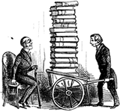
US Supreme Court
The U. S. Supreme Court is free to accept or reject the appellate cases it will hear.
Most Supreme Court cases deal with:
  Significant federal or constitutional issues
  Conflicting decisions by circuit courts
  Controversial constitutional interpretation by circuit courts about state or local law

Slide 15
The Development of the Court
Founders-up to 1789
1789-1861
1861-1936
Present Age

Slide 16
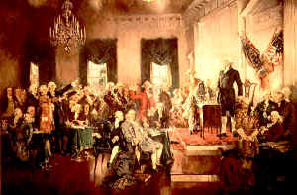
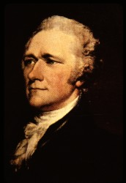
The Framer’s Era
-Up to 1789-1800
Framer’s did not anticipate that the Courts would become so powerful
  Expected judicial review but did not expect the court would play such a large role in making public policy
Hamilton’s view of Court
  Was “least dangerous branch”
  Should not have power over the other branches especially the Executive Branch

Slide 17
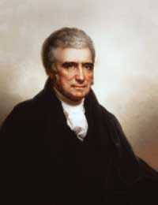
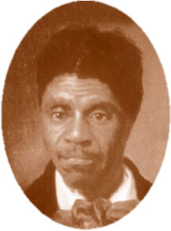
The Marshall Era
1801-1860
Major Issues
National Supremacy
  The Marshall Court till 1835
    Marbury v Madison
    McCulloch v Maryland
  Interstate commerce clause is placed under federal control
  Slavery also an issue
    The Taney Court
    Dred Scott v Sanford

Slide 18
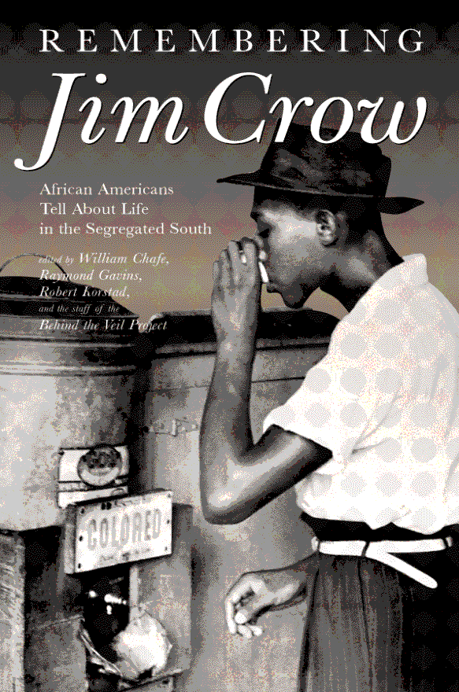
The Late 19th- Early 20th Century
1861-1936
Major Issues
The Government and the Economy
    Under what circumstances should the state governments regulate the economy?
    Under what circumstances should the federal government regulate the economy?
    Supportive of private property in most cases
Jim Crow laws
The Courts interpreted the 14th Amendment (citizenship) and 15th Amendment (voting rights) very narrowly and allowed “Jim Crow” laws to exist
  The opposite “broadly interpreted” would not have allowed these laws and/or codes to exist

Slide 19
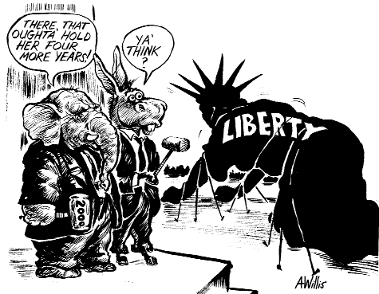
The Modern Era
1936 to the Present
Major Issues
  Balance:
    Government and Political Liberties
    More attention on civil liberties
  Balance:
    Government and economic regulations
    Power struggle between states and federal government

Slide 20
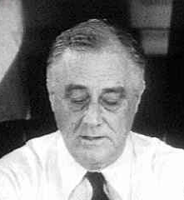
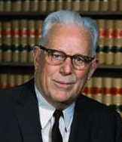
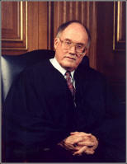
Also Important in Modern Era
  The FDR “court packing scheme”
  Three Modern Courts
    The Warren Court- Civil Rights and Civil Liberties
    The Rehnquist Court- A revival of state rights in some cases
    The Roberts Court-Seems to follow the Rehnquist model of states rights but also not afraid to use federal power in some cases

Slide 21
FDR’s Court Packing Scheme
Early in 1937, FDR tried to pass a court reform bill designed to allow the president to appoint an additional Supreme Court justice for each current justice over the age of 70, up to a maximum of six appointments.
Though he claimed that the measure was offered in concern for the workload of the older justices, most observers saw the proposal as an obvious attempt to dilute the power of the older, conservative justices.
  The Senate voted against the proposal on July 22, 1937.
Many claim that the proposed bill resulted in a loss of credibility for FDR that helped to slow the New Deal to a standstill.

Slide 22
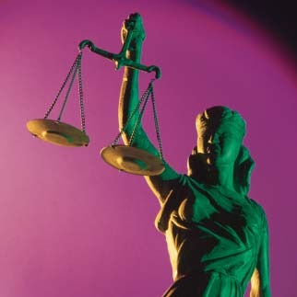
Checks on the Court
The President
  Appoints justices and federal court judges
Congress
  Confirmation
  impeachment cases
  Can change the number of district courts

Slide 23
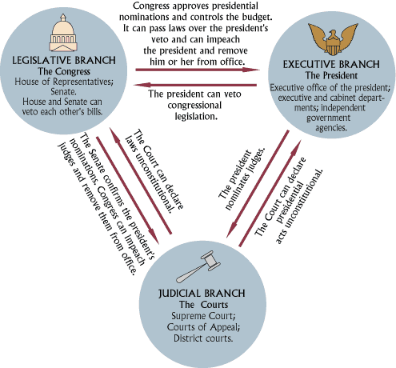

Slide 24
Confirmation of Federal Judges
All federal judges must be appointed by the president and confirmed by the Senate… not just the 9 Supreme Court Justices
These appointments are for life
  (AKA…”good behaviour” )

Slide 25
The Power of the Court
Judicial Review
  Only around 150 laws and presidential acts and agreements have been declared unconstitutional (as of the 2000’s)
  These came from the Legislative Branch and/or the Executive Branch
Appellate Power
  Only 260 cases overturned since 1810
  This means the Court does not follow stare decisis
    a legal term meaning “Let the decision stand”

Slide 26
Unconstitutional and Preempted Laws 1789-2002
According to the GPO (Government Printing Office Database):
1789-2002 Acts of Congress Held as Unconstitutional- 158
1789-2002 State Constitutional and Municipal Ordinances held Unconstitutional or Preempted by Federal Law-224
1789-2002 Total Laws Overturned-382
The most current information includes only US Supreme Court decisions made between 1789 and 2002. The data shown does not include either state or federal laws overturned from 2003-present because statistics have yet to be compiled for that period.

Slide 27
How the Court Operates
The Court has had 9 justices at a time since the mid-1800s.
Name of the case:
  The person or group that is suing at the Supreme Court level is listed first.
  The person or group that is defending at the Supreme Court level is listed second.
  The year that case was decided by the Court is then shown.

Slide 28
How the Court Operates
Notes about the name:
  The person/group suing is the one who lost previously at the most recent hearing.
  This can occur at the federal appeals level or State Supreme Court level.
  Similar cases from other circuits are often “attached” to a lead case.
  Sometimes the case is associated, or listed, with the Chief Justice from that year.
This is traditional and does not mean that the Chief voted with the majority or
wrote the court’s “opinion”.

Slide 29
How the Court Operates
Vote Results:
  Sometimes there are less than 9 votes.
  This signals that a justice was ill, chose not to vote, or the court had a vacancy.
Majority Opinion:
  Five to nine justices voted to make the decision. This now becomes the ruling for the nation.
  Any one of the majority voters can be asked to write the opinion of the court which becomes the legal guideline of how the court wants this decision to be used by the country.

Slide 30
How the Court Operates
Minority or Dissenting Opinion:
  One to four justices voted against the final decision. They can explain why in their own essays and hope that the legal community will use the logic for further debates about the issue being resolved.
Concurring Opinion:
  Any justice from the majority group can present a more personal interpretation of the case. This is usually done when a member of the majority doesn’t agree with everything in the Majority Opinion, or wants to add a personal interpretation of that decision.

Slide 31
How the Court Operates
Per Curium Decision:
  The Supreme Court members might not publish an opinion statement about a case. They only say which side won. This usually means that the court has agreed with lower court’s interpretations and they feel that another opinion statement is redundant or unnecessary.
Amicus Curiae Briefs (“Friends of the Court” Essays)
  Legal groups from around the political spectrum discover that they have a vested interest in a case being heard by federal courts. They submit arguments to the Court requesting that the court emphasize issues of concern. These summaries help the Court see the implications of various possible decisions they might make on a case.

Slide 32
Can Federal Court Decisions be Undone??
No, not officially, but yes in these ways
  By changing the number of judges and/or justices
    FDR and court packing
  By revising legislation in Congress at a later date
    When there are new members on Court
  By amending the Constitution
    This would supersede all rulings by Court on subject
  By altering the jurisdiction of the Court
    Congress may do this but only in lower federal courts, not Supreme Court
    Causes difficulties in checks and balances
  By restricting the remedies of the Court
    Executive branch refuses to enforce the ruling
      Jackson and Indian Removal Act
    Causes difficulties in checks and balance

Slide 33
Politics and the Federal Courts
The Judicial Branch was designed to be above politics but politics still plays a major role in many judicial decisions
Appointments by Executive Branch
Confirmation hearings by Senate
Political beliefs of judges and justices
  What should be considered when cases are being decided?
  Should the Constitution be the only thing considered upon deciding a case?
  How much power should federal judges have?
  What should they use when deciding a case?
    Judicial restraint or constructivism
    Judicial activism

Slide 34
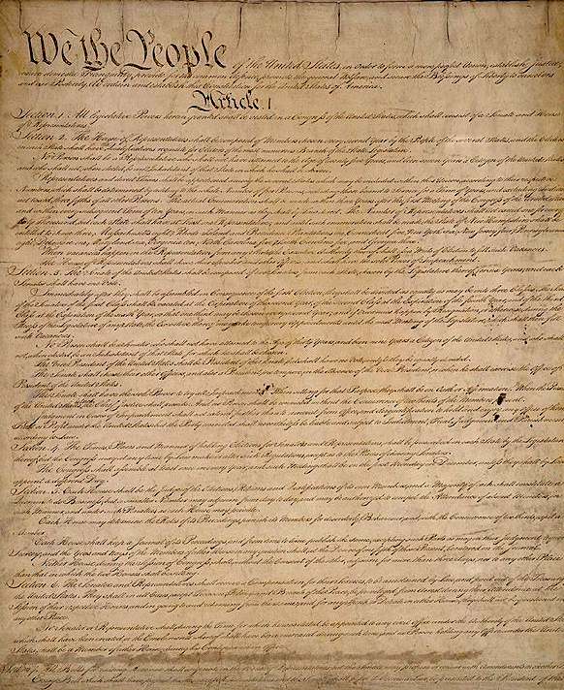
Judicial Restraint
The view that the justices and judges should not read the their own philosophies or policy preferences into the Constitution and laws
Judges should whenever reasonably possible construe the law so as to avoid second guessing the policy decisions made by other governmental institutions such as Congress, the President and state governments within their constitutional spheres of authority.

Slide 35
Judicial Restraint vs. Judicial Activism
In your opinion, should SCOTUS Justices practice judicial restraint (looking at original intent) or judicial activism (applying the USC to present day)?
Why do you believe this?

Slide 36
Strict Constructivism
Very closely related to judicial restraint
A strict constructivist would ask:
  What did the Framers MEAN when they wrote that section and/or clause??
Most constructivist judges consider ‘original intent’ when deciding on cases
    In other words, what did the Framers INTEND by that article, section, or clause??

Slide 37
Judicial Activism
The opposite of judicial restraint
The view that the Supreme Court justices (and lower court judges) can and should creatively reinterpret the texts of the Constitution and the laws
  The judges will considered the vital needs of society when the other two branches and/or the various state governments seem to them to be failing to meet these needs.
It is often argued that judicial activism is used to further a judge's political agenda

Slide 38
The Great Debate
If a judge rules contrary to popular opinion (think Roe v. Wade) is that judicial activism??
OR if a judge rules contrary to YOUR opinion is that judicial activism??
  Liberals charge that the decision in US v Lopez was motivated by pro-gun sentiments on the Court
  Conservatives charge that Roe v Wade and Planned Parenthood v Casey were motivated by pro-abortion sentiments on the Court.

Slide 39
The Great Debate
Arguments Against Judicial Activism
  Judges are creating a new LAWS by “legislating from the bench”
  Roe v Wade
Arguments for Judicial Activism
  Necessary when the majority does not respect the rights and/or needs of the minority
  Brown v Board
    SCALIA/BREYER VIDEO ON ORIGINAL INTENT VS ACTIVISM

Slide 40
Court Terms to Know
Writ of certiorari - A decision to hear an appeal from a lower court. Approximately 100 cases per year granted a writ of certiorari by the Supreme Court.
Stare decisis a legal term meaning “Let the decision stand”. This occurs when judges/justices do not overturn a lower court’s decision.
In forma pauperis- When the costs of a court case are paid by government and thus no cost to the defendant
Standing- who is allowed to bring a case; the right to file a lawsuit or file a petition
Class action cases- A law suit brought on behalf of all similarly situated persons; usually
Amicus curiae are legal briefs written by supporters- “friends of the court”- often interest groups that want a decision in their favor

Slide 41
Required Supreme Court Cases
Gideon v Wainwright 1963
Escobedo v Illinois 1964
Miranda v Arizona 1966
Mapp v Ohio 1961
Roe v Wade 1973
Planned Parenthood v Casey 1992
Furman v Georgia 1972
Gregg v Georgia 1976
Citizens United v FEC- 2010
Marbury v Madison 1803
McCulloch v Maryland 1819
Gibbons v Ogden 1824
Barron v Baltimore 1833
Gitlow v NY 1925
Dred Scott v Sandford 1857
Plessey v. Ferguson 1898
Brown v Board 1954
Brown v Board II 1955

Slide 42
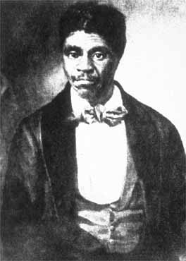
Dred Scott v. Sandford (1856)
Facts of the Case
  Dred Scott was a slave in Missouri. From 1833 to 1843, he resided in Illinois (a free state) and in an area of the Louisiana Territory, where slavery was forbidden by the Missouri Compromise of 1820.
  After returning to Missouri, Scott sued unsuccessfully in the Missouri courts for his freedom, claiming that his residence in free territory made him a free man.
  Scott then brought a new suit in federal court. Scott's master maintained that no pure-blooded Negro of African descent and the descendant of slaves could be a citizen in the sense of Article III of the Constitution.
Question Presented
  Was Dred Scott free or slave?

Slide 43
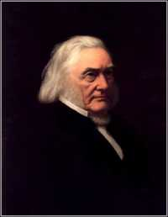
Conclusion
  The Court ruled that Dred Scott was a slave and according to the Court no one but a citizen of the United States could be a citizen of a state, and that only Congress could confer national citizenship.
  The conclusion upheld the idea that no person descended from an American slave had ever been a citizen
  The Court then declared that the Missouri Compromise unconstitutional, hoping to end the slavery question once and for all.
Chief Justice Roger B. Taney

Slide 44
Munn v. Illinois (1877)
Facts of the Case
  The state of Illinois regulated grain warehouse and elevator rates and establishing maximum rates for their use. The owners sued claiming they should be able to decide how much they should charge for their services
Questions Presented
  Did the state-imposed rates deny the warehouse and elevator owners equal protection and due process under the 14th Amendment?

Slide 45
Munn v. Illinois (1877)
Conclusion
  No on both counts. The states may regulate the use of private property "when such regulation becomes necessary for the public good." When property has a public interest, it ceases to be private only.

Slide 46
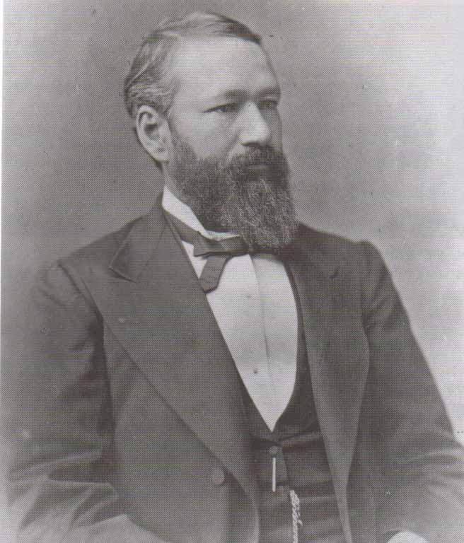
Plessey v. Ferguson (1896)
Facts of the Case
The state of Louisiana enacted a law that required separate railway cars for blacks and whites. In 1892, Homer Adolph Plessey--who was seven-eighths Caucasian--took a seat in a "whites only" car of a Louisiana train.
  He refused to move to the car reserved for blacks and was arrested.

Slide 47
Plessey v. Ferguson (1896)
Question of Law
Is Louisiana's law mandating racial segregation on its trains an unconstitutional infringement on both the privileges and immunities and the equal protection clauses of the Fourteenth Amendment?

Slide 48
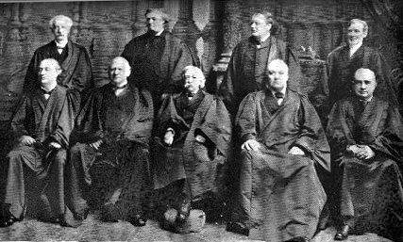
Conclusion
No, the state law is within constitutional boundaries and state-imposed racial segregation upheld by the Court.
The justices based their decision on the separate-but-equal doctrine, that separate facilities for blacks and whites satisfied the Fourteenth Amendment so long as they were equal.
  In short, segregation does not in itself constitute unlawful discrimination
The Fuller Court- circa 1898
(Melville Fuller center)

Slide 49
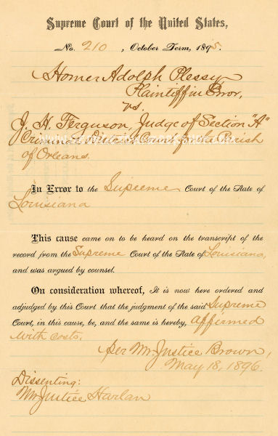
Actual
Court Decision

Slide 50
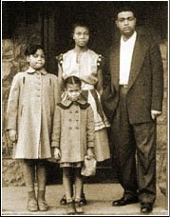
Brown v. Board of Education of Topeka (1954)
Facts of the Case
  Black children were denied admission to public schools attended by white children under laws requiring or permitting segregation according to the races. The white and black schools approached equality in terms of buildings, curricula, qualifications, and teacher salaries.
Question Presented
  Does the segregation of children in public schools solely on the basis of race deprive the minority children of the equal protection of the laws guaranteed by the 14th Amendment? (See Plessey v Ferguson- separate BUT equal)

Slide 51
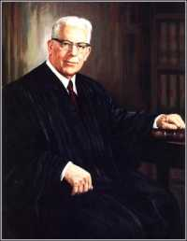
Conclusion
  The Court said “Yes!”
  Racial segregation in public education has a detrimental effect on minority children because it is interpreted as a sign of inferiority.
  The long-held doctrine that separate facilities were permissible provided they were equal was rejected. Separate but equal is inherently unequal in the context of public education.
  The unanimous opinion sounded the death-knell for all forms of state-maintained racial separation
Chief Justice Earl Warren

Slide 52
Brown v Board II 1955
  Facts of the Case
  After its decision in Brown I which declared racial discrimination in public education unconstitutional, the Court convened to issue the directives which would help to implement its newly announced Constitutional principle. Given the embedded nature of racial discrimination in public schools and the diverse circumstances under which it had been practiced, the Court requested further argument on the issue of relief.
  Question
  What means should be used to implement (carry out) the principles announced in Brown I?

Slide 53
Importance
  The Court held that the problems identified in Brown I required varied local solutions. Chief Justice Warren conferred much responsibility on local school authorities and the courts which originally heard school segregation cases. They were to implement the principles which the Supreme Court embraced in its first Brown decision.
  Warren urged localities to act on the new principles promptly and to move toward full compliance with them "with all deliberate speed."

Slide 54
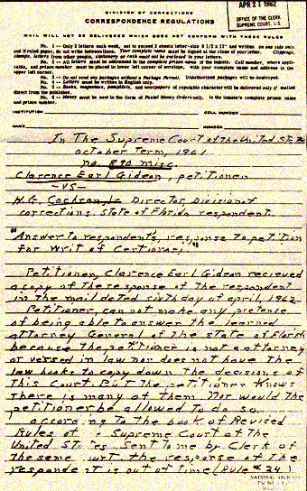
Gideon v Wainwright (1963)
Facts of the Case
  Gideon was charged in a Florida state court with a felony for breaking and entering a pool hall. He lacked funds and was unable to hire a lawyer to prepare his defense. When he requested the court to appoint an attorney for him, the court refused, stating that it was only obligated to appoint counsel to indigent defendants in capital cases.
  Gideon defended himself in the trial; he was convicted by a jury and the court sentenced him to five years in a state prison.

Slide 55
Gideon v Wainwright (1963)
Question Presented
  Did the state court's failure to appoint counsel for Gideon violate his right to a fair trial and due process of law as protected by the Sixth and Fourteenth Amendments?

Slide 56
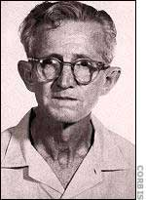
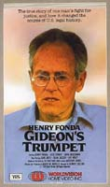
Conclusion
  In a unanimous opinion, the Court ruled that Gideon had a right to be represented by a court-appointed attorney.
  In this case the Court found that the Sixth Amendment's guarantee of counsel was a fundamental right, essential to a fair trial, which should be made applicable to the states through the Due Process Clause of the Fourteenth Amendment.
    Justice Black called it an "obvious truth" that a fair trial for a poor defendant could not be guaranteed without the assistance of counsel.

Slide 57

Escobedo v. Illinois (1964)
Facts of the Case
  Danny Escobedo was arrested and taken to a police station for questioning. Over several hours, the police refused his repeated requests to see his lawyer.
  Escobedo's lawyer sought unsuccessfully to consult with his client.
    Escobedo subsequently confessed to murder.
Question Presented
  Was Escobedo denied the right to counsel as guaranteed by the Sixth Amendment?

Slide 58
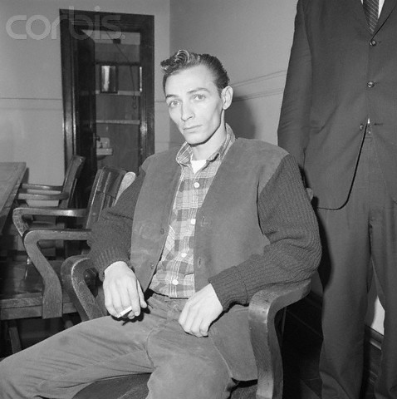
Conclusion
  Yes…the Court agreed with Escobedo
  He should have been able to discuss with his lawyer
  Escobedo had not been adequately informed by his lawyer of his constitutional right to remain silent rather than to be forced to incriminate himself.

Slide 59
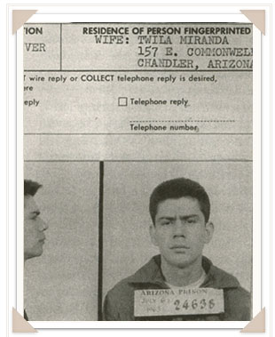
Miranda v. Arizona (1966)
Facts of the Case
  Ernesto Miranda an Arizona native with only an elementary school education, was arrested for robbery, kidnapping, and rape.
  He was interrogated by police and confessed without knowing he could ask for a lawyer.
  At trial, prosecutors offered only his confession as evidence. Miranda was convicted of rape and kidnapping and sentenced to 20 to 30 years on both charges.

Slide 60
Miranda v. Arizona (1966)
Question Presented
  Does the police practice of interrogating individuals without notifying them of their right to counsel and their protection against self-incrimination violate the Fifth Amendment?

Slide 61
Conclusion
The Court ruled for Miranda
It then specifically outlined police warnings suspects, including warnings of the right to remain silent and the right to have counsel present during interrogations.
  AKA…The Miranda Warnings
    This is a generic example…all states’ Miranda warnings differ slightly
    You have the right to remain silent. If you give up that
    right, anything you say can and will be used against you
    in a court of law. You have the right to an attorney and to
    have an attorney present during questioning. If you
    cannot afford an attorney, one will be provided to you at
    no cost. During any questioning, you may decide at any
    time to exercise these rights, not answer any questions, or
    make any statements.

Slide 62
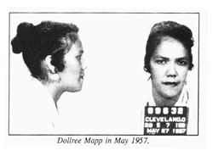
“Mapp v Ohio 1961
4th Amendment Case
Facts
  Dolree Mapp was convicted of possessing obscene materials after an admittedly illegal police search of her home for a fugitive. She appealed her conviction on the basis of freedom of expression.
    Search and seizure” case
    Search of home by police found illegal materials without warrant
  Is this constitutional?

Slide 63
Importance
“Search and Seizure” Cases
  No! The Court ruled for Mrs. Mapp
  The Exclusionary Rule was established
  Without warrant, items could not be used against Mapp
  This is known as the “Fruit of a poisonous tree”
  FYI, if police are in hot pursuit of criminals they can be given the “good faith exception” in most cases

Slide 64
5th Amendment Eminent Domain
Kelo v City of New London, CT, 2005
Facts of the Case
New London, a city in Connecticut, used its eminent domain authority to seize private property to sell to private developers.
The city said developing the land would create jobs and increase tax revenues.
The property owners argued the city violated the Fifth Amendment's takings clause, which guaranteed the government will not take private property for public use without just compensation.
  Specifically the property owners argued taking private property to sell to private developers was not public use.
Question
Does a city violate the Fifth Amendment's takings clause if the city takes private property and sells it for private development, with the hopes the development will help the city's bad economy?

Slide 65

Importance of Kelo
Conclusion
No. In a 5-4 opinion delivered by Justice John Paul Stevens, the majority held that the city's taking of private property to sell for private development qualified as a "public use" within the meaning of the takings clause.
The city was not taking the land simply to benefit a certain group of private individuals, but was following an economic development plan.
  The takings here qualified as "public use" despite the fact that the land was not going to be used by the public.
The Fifth Amendment did not require "literal" public use, the majority said, but the "broader and more natural interpretation of public use as 'public purpose.'"

Slide 66
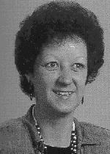
Roe v. Wade (1973)
1st and 14th Amendments
Right to Privacy
Facts of the Case
  Roe, a Texas resident, sought to terminate her pregnancy by abortion. Texas law prohibited abortions except to save the pregnant woman's life.
Question Presented
  Does the Constitution through the 1st amendment AND 14th amendment embrace a woman's right to terminate her pregnancy by abortion?
Jane Roe, who was no longer pregnant when the Supreme Court decided her challenge to Texas's abortion law.

Slide 67
Conclusion
  The Court held that a woman's right to an abortion fell within the right to privacy (recognized in Griswold v. Connecticut) protected by the Fourteenth Amendment.
  The decision gave a woman total autonomy over the pregnancy during the first trimester and defined different levels of state interest for the second and third trimester.
  As a result, the laws of 46 states were affected by the Court's ruling.

Slide 68
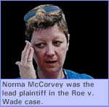
"Jane Roe" switches sides
In an interesting turn of events, "Jane Roe," whose real name is Norma McCorvey, became a member of the pro-life movement following her conversion to Christianity, and now fights to make abortion illegal.
Using her prerogative as a party to the original litigation, she sought to reopen the case in a U.S. District Court in Texas and have it overturned.
Her new stance is based on claims made since the decision, claiming evidence of emotional and other harm suffered by many women who have had abortions, and increased resources for the care of unwanted children.
On June 19, 2003, the judge that the motion was not made within a "reasonable time." On February 22, 2005, the Supreme Court refused to grant a writ of certiorari, ending McCorvey's appeal.

Slide 69
1st and 14th Amendments
More Right to Privacy Cases
Webster v Reproductive Health Services, 1989
  Facts-Abortion clinics could limit abortions to before 20 weeks in Missouri
  Conclusion-Affirmation of Roe but a roll back of Roe and privacy rights
Planned Parenthood v. Casey, 1992
  Facts-Pennsylvania case in which a 24 hour waiting period, and a law requiring parental permission were upheld
  Conclusion-An affirmation of Roe but another rollback of Roe

Slide 70
Furman v Georgia, 1972
Facts of the Case
Furman was burglarizing a private home when a family member discovered him.
  He attempted to flee, and in doing so tripped and fell.
  The gun that he was carrying went off and killed a resident of the home.
He was convicted of murder and sentenced to death.
Question
Does the imposition and carrying out of the death penalty in these cases constitute cruel and unusual punishment AND due process clauses in violation of the Eighth and Fourteenth Amendments?

Slide 71
Importance
Conclusion
Yes. The imposition of the death penalty in this cases constituted cruel and unusual punishment and violated the Constitution.
The Court's decision forced states and the national legislature to rethink their statutes for capital offenses to assure that the death penalty would not be administered in a capricious or discriminatory manner.
Set up 4-year moratorium on the death penalty

Slide 72
Gregg v Georgia, 1976
Facts of the Case
A jury found Gregg guilty of armed robbery and murder and sentenced him to death.
  On appeal, the Georgia Supreme Court affirmed the death sentence except as to its imposition for the robbery conviction.
Gregg challenged his remaining death sentence for murder, claiming that his capital sentence was a "cruel and unusual" punishment that violated the Eighth and Fourteenth Amendments.
Question
Is the imposition of the death sentence prohibited under the Eighth and Fourteenth Amendments as "cruel and unusual" punishment?

Slide 73
Gregg v Georgia
Conclusion
No. In a 7-to-2 decision, the Court held that a punishment of death did not violate the Eighth and Fourteenth Amendments under all circumstances.
In extreme criminal cases, such as when a defendant has been convicted of deliberately killing another, the careful and judicious use of the death penalty may be appropriate if carefully employed.
Moreover, the Court was not prepared to overrule the Georgia legislature's finding that capital punishment serves as a useful deterrent to future capital crimes and an appropriate means of social retribution against its most serious offenders.

Slide 74
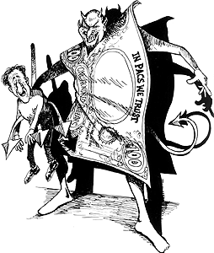
Political Action Committees (PAC’s)
PAC’s are private groups organized to elect or defeat government officials and promote legislation
A PAC must register six months in advance, have at least fifty contributors, and give to at least five candidates.
  There are over 4,000 PACs registered with the Federal Election Commission.
PACs may donate
  $5,000 per candidate, per election
  $15,000 to national party chairman
  $5000 to local, state, and district committees
  $5000 to other PAC’s

Slide 75
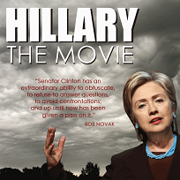
Citizens United v FEC (2010)
Facts of the Case
Citizens United sought an injunction against the Federal Election Commission to prevent the application of the Bipartisan Campaign Reform Act (BCRA) to its film Hillary: The Movie.
  The Movie expressed opinions about whether Senator Hilary Rodham Clinton would make a good president.
In an attempt to regulate "big money" campaign contributions, the BCRA applied a variety of restrictions to "electioneering communications.
  The BCRA (McCain-Feingold Act) prevents corporations or labor unions from funding such communication from their general funds and require the disclosure of donors a disclaimer when the communication is not authorized by the candidate it intends to support.
Citizens United argued that its First Amendment rights had been violated.

Slide 76
Importance
Rules Left in Place
  The Court further held that the BCRA's disclosure requirements as applied to The Movie were constitutional.
  The Court held that political speech may be banned based on the speaker's corporate identity.
  The Court reasoned that revealing the identity of the ad’s sponsor is justified by a "governmental interest" in providing the "electorate with information" about election-related spending resources.
Rule that were Changed
  The government may not limit corporate independent expenditures.
  The First Amendment does not allow the government to impose restrictions on certain on corporations or labor unions.
    Political speech is "indispensable" to a democracy, which is no less true because the speech comes from a corporation.

Slide 77
Super PACs
Super PACs are a new kind of political action committee created in July 2010 following of Citizens United
  Technically they are known as “independent expenditure-only committees”
http://www.colbertnation.com/the-colbert-report-videos/382014/april-14-2011/colbert-super-pac---trevor-potter

Slide 78
Super PACs
Super PACs may raise unlimited sums of money from
  Corporations
  Unions
  Associations and individuals
  They spend unlimited sums to overtly advocate for or against political candidates.
    Unlike traditional PACs, Super PACs are prohibited from donating money directly to political candidates.
  Super PACs must, however, report their donors to the Federal Election Commission on a monthly or quarterly basis -- the Super PAC's choice -- as a traditional PAC would

